Slide 1
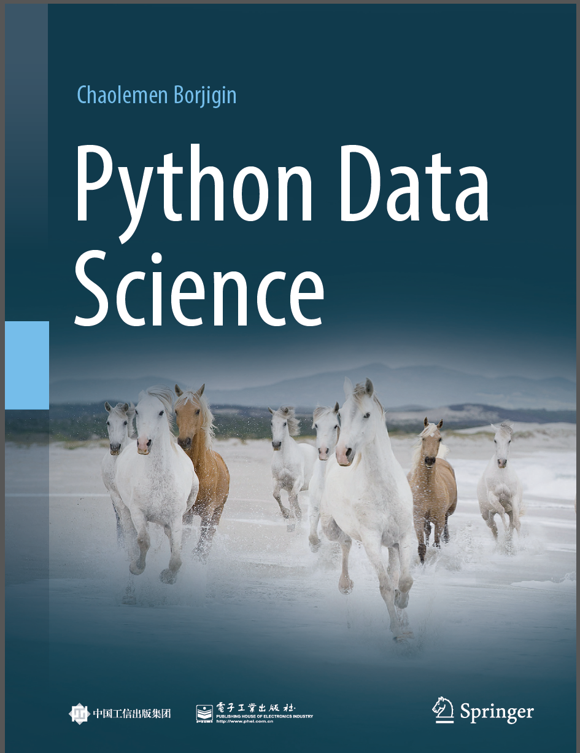
Python Data Science
Chaolemen Borjigin
Renmin University of China
chaolemen@ruc.edu.cn

Slide 2
3.1 Iterators and generators
▼ Chapter 3 Advanced Python Programming for Data Science
► 3.1 Iterators and generators
Chaolemen Borjigin
Renmin University of China
chaolemen@ruc.edu.cn

Slide 3
Summary of this chapter
▼ Chapter 3 Advanced Python Programming for Data Science
► 3.1 Iterators and generators
3.1.1 Iterable objects vs. iterators
3.1.2 Generator vs. iterators

Slide 4
3.1.1 Iterable objects vs. iterators
▼Chapter 3 Advanced Python Programming for Data Science
► 3.1 Iterators and generators
In[2]:
myList=[1,2,3,4,5]
next(myList)
TypeError Traceback (most recent call last)
<ipython-input-2-789ab70bd3d5> in <module>
1 myList=[1,2,3,4,5]
----> 2 next(myList)
TypeError: 'list' object is not an iterator

Slide 5
3.1.1 Iterable objects vs. iterators
▼Chapter 3 Advanced Python Programming for Data Science
► 3.1 Iterators and generators
In[3]:
myIterator=iter(myList)
print(next(myIterator))
print(next(myIterator))
print(next(myIterator))
1
2
3

Slide 6
3.1.2 Generator vs. iterators
▼Chapter 3 Advanced Python Programming for Data Science
► 3.1 Iterators and generators
In[5]:
def myGen():
x=range(1,11)
for i in x:
yield i+2
In[6]:
myGen()
Out[6]:
<generator object myGen at 0x0000029C801734C0>

Slide 7
3.1.2 Generator vs. iterators
▼Chapter 3 Advanced Python Programming for Data Science
► 3.1 Iterators and generators
In[7]:
for x in myGen():
print(x,end=",")
3,4,5,6,7,8,9,10,11,12,

Slide 8


